Slide 1

Coffee Roaster optimization
Olivia Donkus

Slide 2
THE PROBLEM
Client: Warehouse Manager / Coffee Roaster
Goal: Program to decide on how to use beans most efficiently with either:
Maximum profit
Minimal Waste
Challenges:
Blends with different ratios
Balance inventory and income

Slide 3
Solution
Utilized OOP to manage

Slide 4
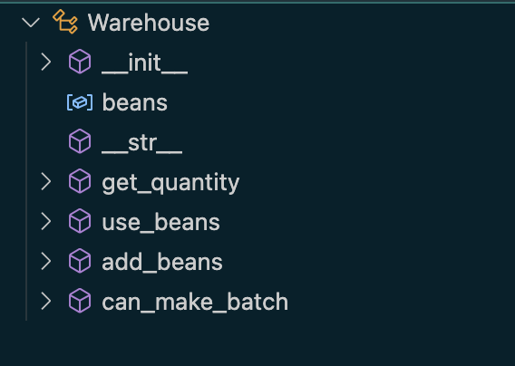
Warehouse
Keeps track of bean inventory and ensures batches can be made
Handles adding, using, and checking stock

Slide 5
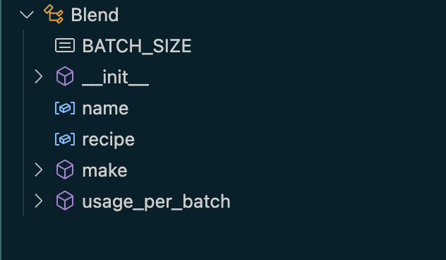
BLEND
Defines each coffee blend’s recipes
Handles math for making each batch
Polymorphism present here!

Slide 6
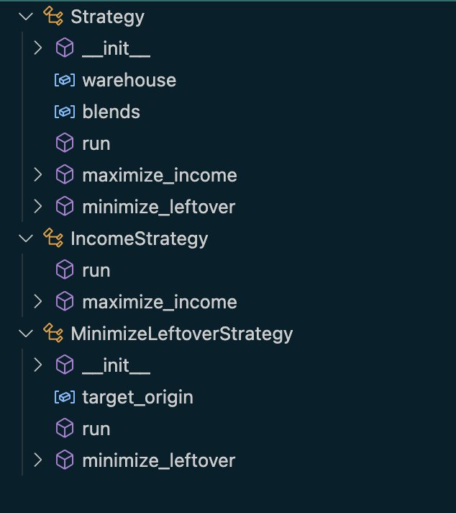
Strategy (and subclasses)
Strategy used as a starting template
Accesses the warehouse and the blends
Sets up for specific strategies to do the work
Income Strategy picks blends that make the most money
Minimize Leftover Strategy focuses on using up as much of one type of bean as possible
Polymorphism present here!
Notes:
Warehouse ↔ Blend: The Blend asks the Warehouse if enough beans exist.
Strategy ↔ Blend: The Strategy decides which blend to make next.
Strategy ↔ Warehouse: The Strategy updates the warehouse as batches are made.

Slide 7
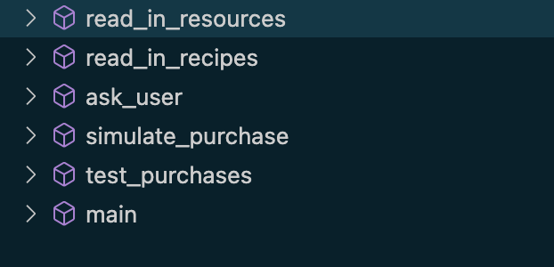
DRIVER
Connects everything
Loads data
Lets user pick a strategy
Prints results

Slide 8
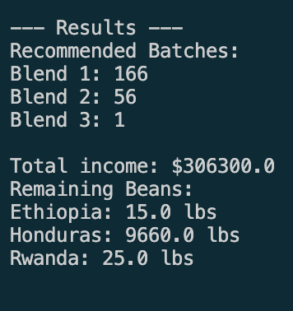
Results: Maximize Profit

Slide 9
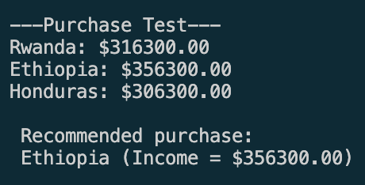
Results: Maximize Profit With Additional Budget And Warehouse Space

Slide 10
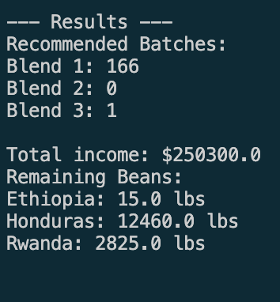
Results: Minimize Waste Ethiopia Beans

Slide 11
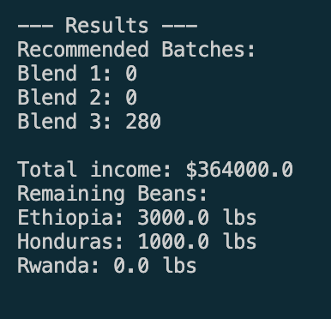
Results: Minimize Waste Honduras Beans
Notes:
Note: Rwanda a limiting resource here

Slide 12
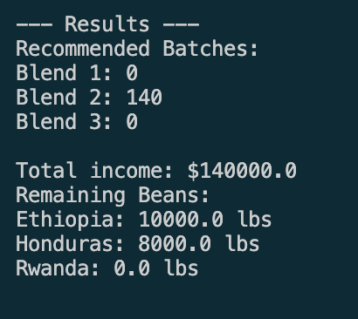
Results: Minimize Waste RWANDA Beans

Slide 13
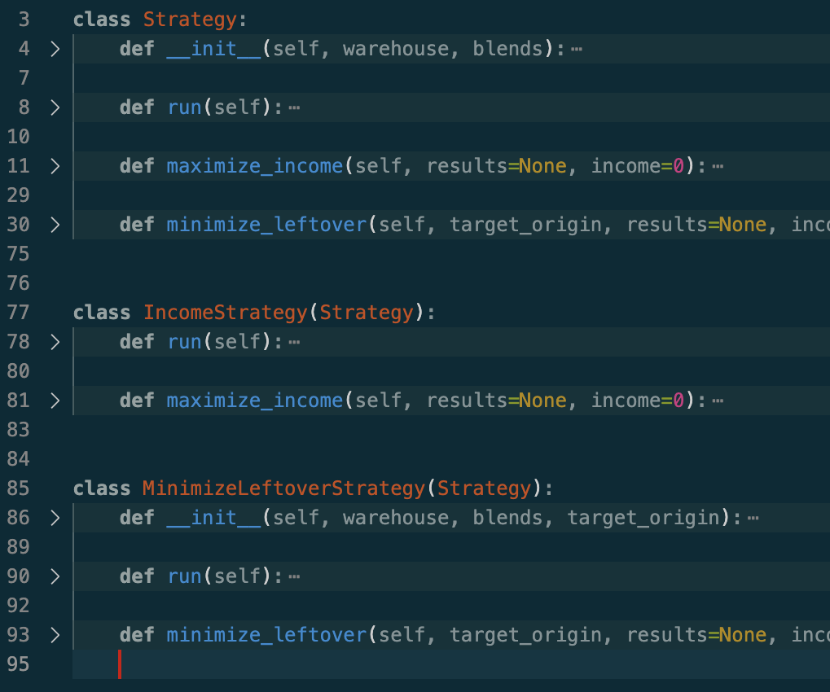
Methods used Inheritance and Polymorphism

Slide 14
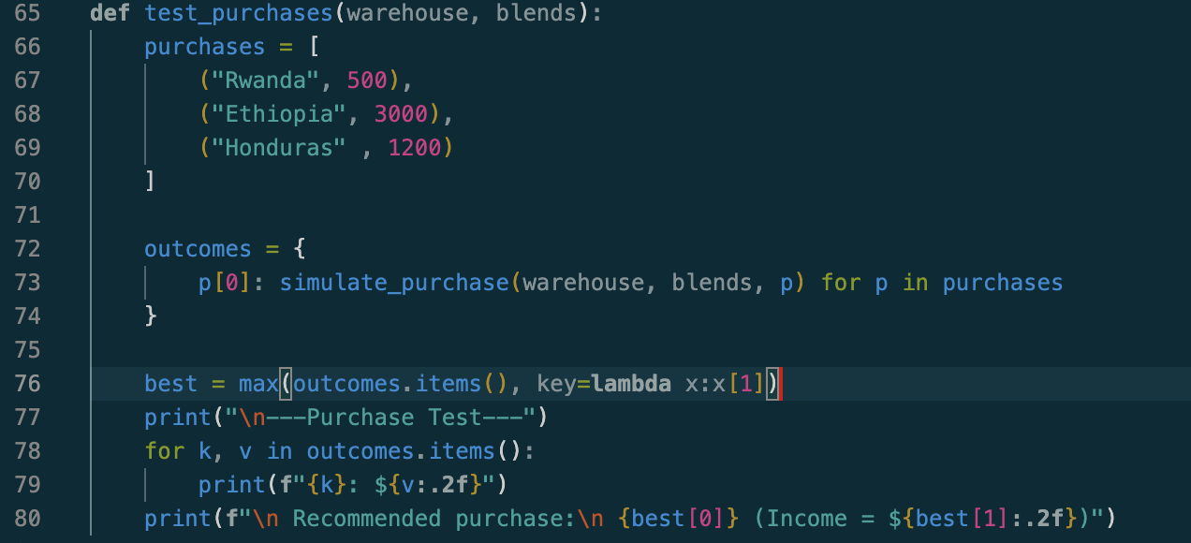
Methods used Lambdas

Slide 15
Methods used Linked List

Slide 16
METHODS

